Slide 1
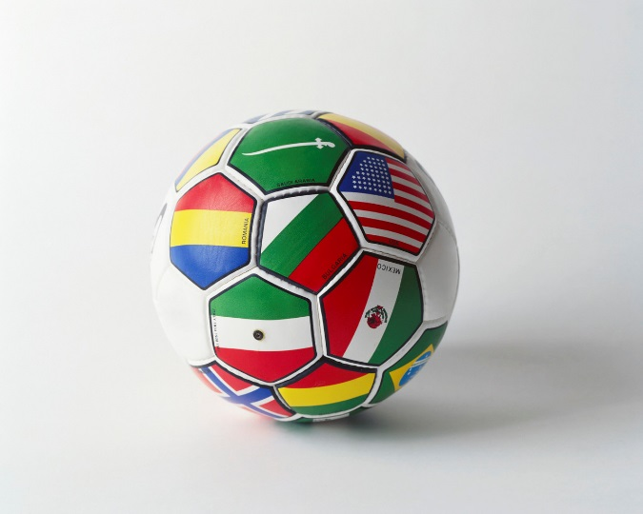

La Copa Mundial

Slide 2
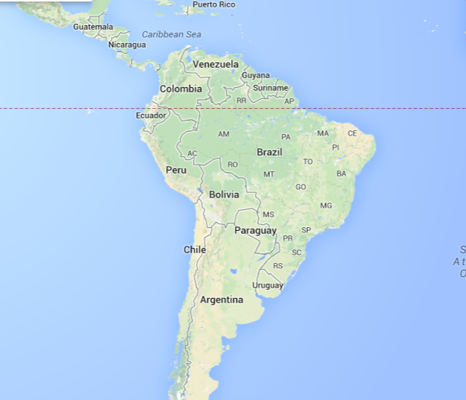
Brasilia

Slide 3
España
México
Honduras
Costa Rica
Colombia
Ecuador
Chile
Argentina
Uruguay
Do you know the countries these flags represent?

Slide 4
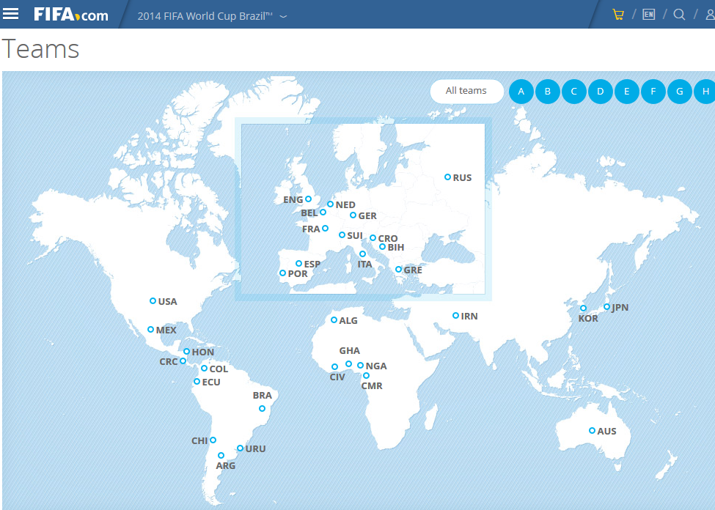

Slide 5
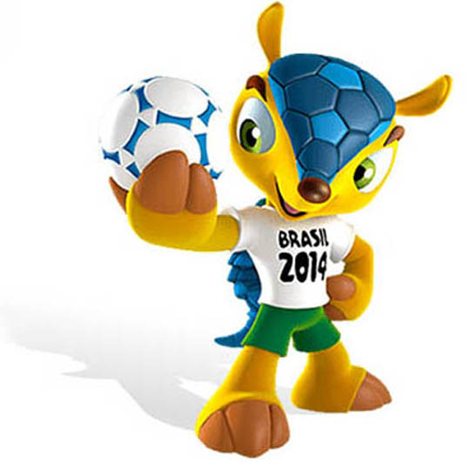
La mascota

